Slide 1
Output Devices, Chapter 4

Slide 2
Objectives
Define the four types of output
Identify the different types of display devices
Describe factors that affect the quality of a monitor
Understand the purpose of a video card
Identify monitor ergonomic issues
Output, Chapter 5

Slide 3
Objectives (Continued)
Explain the differences among various types of printers
List the types of audio output devices
Identify the purpose of data projects, fax machines, and multifunction devices
Explain how a terminal is both an input and output device
Identify output options for physically challenged users.
Output, Chapter 5

Slide 4
What Is Output?
Text
Graphics
Audio
Video
Output, Chapter 5

Slide 5
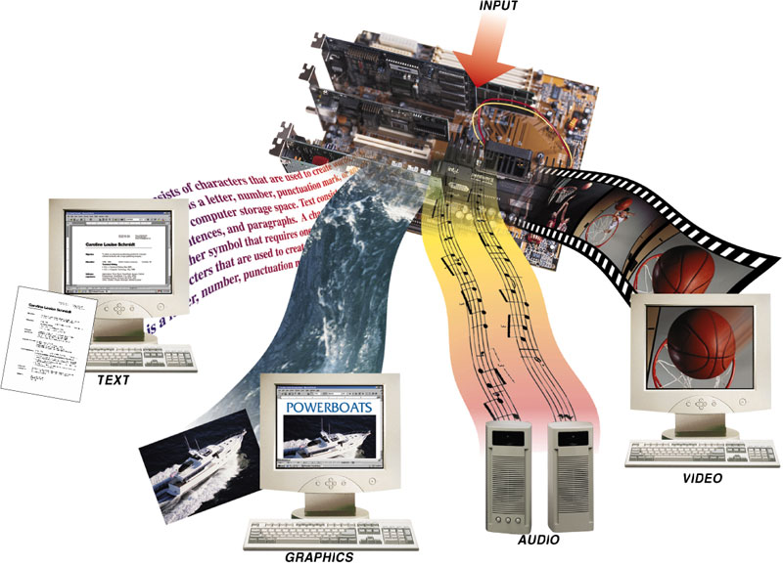
Output, Chapter 5

Slide 6
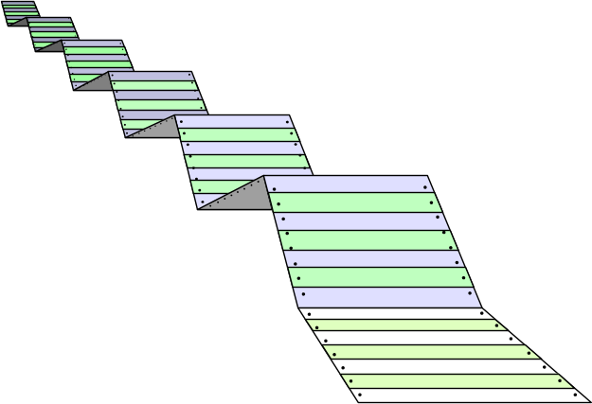
Hard Copy vs. Soft Copy Output
Hard Copy (Paper Output)
Soft Copy
(Monitor Display)
El Centro
College
Output, Chapter 5

Slide 7
Output: Monitors, Printers, Plotters, and Voice
Most output can be divided into two categories: Soft Copy and Hard Copy.
Soft copy includes output from monitors and from audio devices.
Hard copy output includes output from printers, plotters, and microfilm and microfiche.
Output, Chapter 5

Slide 8
What are Output Devices?
Any computer component capable of conveying information to a user
Output, Chapter 5

Slide 9
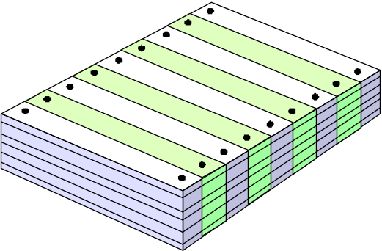
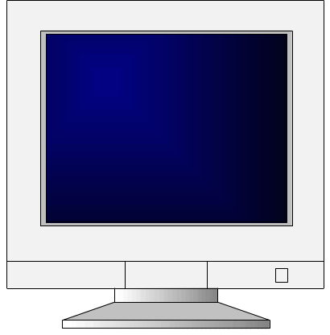
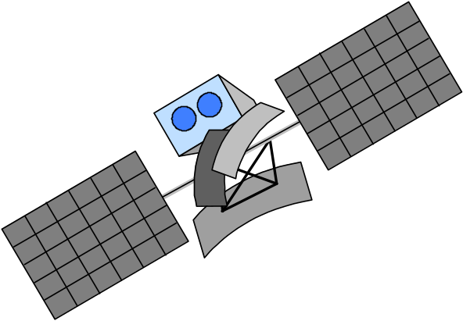
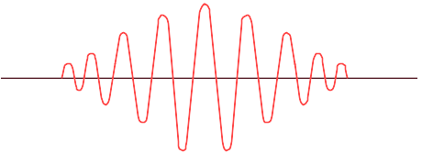
Some Output Devices
Paper
Video Monitor
Sound
Controlling
Other Machines

Slide 10
Types of Output
Soft Copy
Hard Copy
Communications Channel

Slide 11

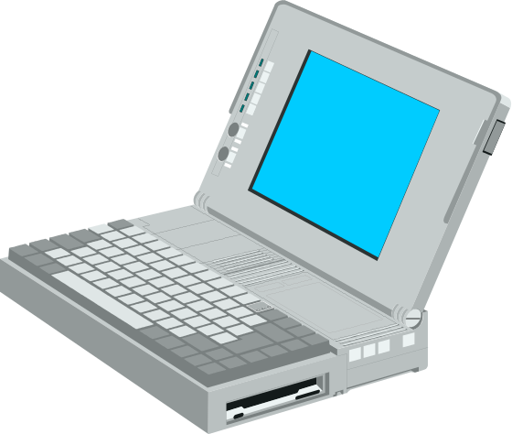
Screen Output – Soft Copy
Video Monitor
  Also called Video Display Terminal (VDT)
  Image exists in video memory—VRAM
  Monitor size is measured diagonally across the screen

Slide 12
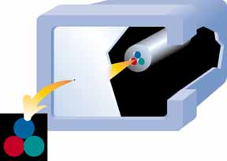
Pixels
Images are made up of
dots called pixels for
picture elements
The number of pixels determines the clarity of the picture on the screen
More pixels = higher resolution = clearer picture

Slide 13
Color Depth (Bit Depth)
This means the amount of information stored in each pixel about what is being shown on the monitor
  Monochrome (1 bit of information per pixel)
    This can only be black or white
  Gray-scale (8 bits of information per pixel)
    This can show more shades of grey
  True color (24 or 32 bits of information per pixel)
    This can realistically reproduce a photograph on the screen that looks very close to the original

Slide 14




Examples of Color Depth
The greater the color depth the more colours that can be represented on the screen
1-bit depth
4-bit depth
8-bit depth
16-bit depth

Slide 15
Output Devices
Any computer component capable of conveying information to a user
Output devices convert machine readable information into people-readable form.
The output devices most commonly used with microcomputers are:
⇨ Monitors
⇨ Printers
⇨ Plotters
⇨ Voice-Output Devices
Output, Chapter 5

Slide 16
Display Devices
An output device that visually conveys text, graphics, and video information
CRT Monitors
  Screen housed in a plastic or metal case
  Color monitor
Output, Chapter 5

Slide 17
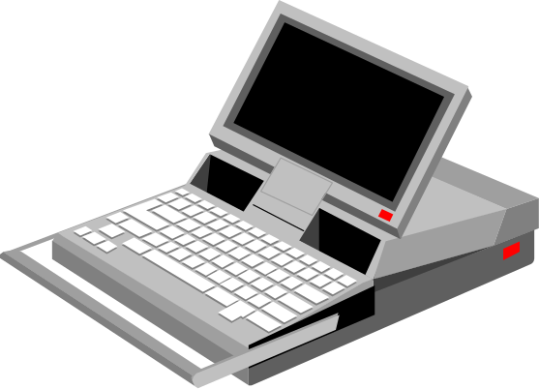
Output Devices = Monitors
Types
  CRT
  Flat-screen
Resolution
  Pixels
  SVGA or VGA
  Monochrome or color
PIXELS
RESOLUTION
Output, Chapter 5
Notes:
*
07/16/96
*
##
5
Output Devices--Monitors
Monitors
- Types of monitors
CRT
Flat-screen
LCD
EL
Gas plasma display
- Resolution determined by pixels
SVGA
XGA
Monochrome or Color

Slide 18
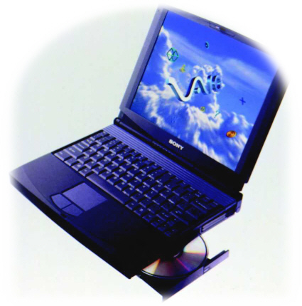
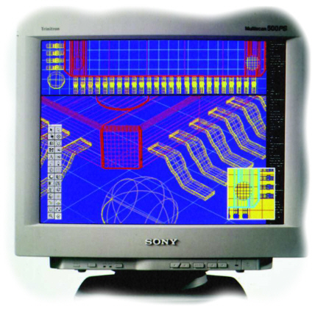
Monitors
cathode ray tube (CRT)
liquid crystal display (LCD)
Laptop color LCD display
Desktop computers use a CRT
Output, Chapter 5

Slide 19
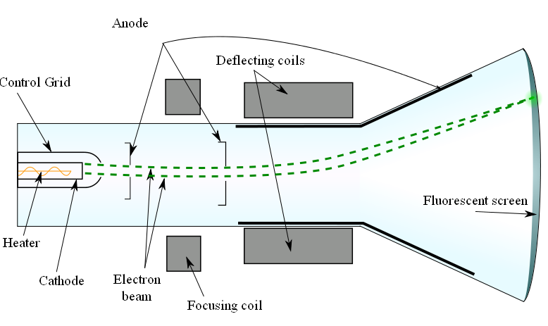
CATHODE RAY TUBE
The cathode ray tube (CRT) is a vacuum tube containing an electron gun
(a source of electrons) and a fluorescent screen, with internal or external means to accelerate and deflect the electron beam, used to create images in the form of light emitted from the fluorescent screen.

Slide 20
Monitors
Monitors are also called:
  display screens
  video display
  video display terminal (VDT).
Output, Chapter 5

Slide 21
Monitors
Images are represented on monitors by individual dots or “picture elements” called pixels.
A pixel is the smallest unit on the screen that can be turned on and off or made different shades.
Output, Chapter 5

Slide 22

Pixels
Output, Chapter 5

Slide 23
Monitors
(Continued)
The density of the dots determine the screen resolution which is the clarity of the images on the screen.
The greater the number of dots on the screen, the better the resolution will be.
Monitors are categorized according to screen resolution as either high resolution or low resolution.
Output, Chapter 5

Slide 24
Monitors
(Continued)
The type of monitor used most often for the office and home is the desktop monitor.
These are also called catherode-ray-tube or CRTs.
Smaller portable monitors are available such as an LCD panel (Liquid Crystal Display) panels.
Output, Chapter 5

Slide 25
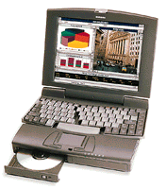
Flat-Panel Monitors
LCD (Liquid Crystal Display)
(Notebooks use LCD displays)
Output, Chapter 5

Slide 26
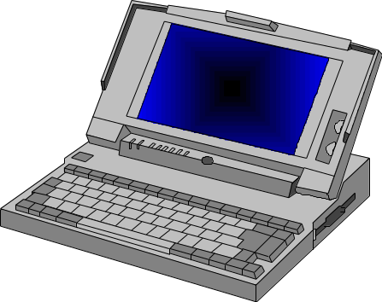
LCD (Liquid Crystal Display)
LCDs comprise flat-panel monitors
Found on watches, calculators, digital cameras and notebook computers
  Lighter weight
  Crisp,clear images
  Extra viewing area for same size
  More expensive to buy
  Consume less power

Slide 27
Flat-Panel Monitors (Continued)
Data projectors
  Allows an audience to view output
  LCD projectors
  Digital light processing (DLP) projector
Output, Chapter 5

Slide 28
Screen Size
Quoted Size and Actual Viewable Area
Monitor Size Viewable Area
21 inches 20 inches
17 inches 16 inches
15 inches 14 inches
Output, Chapter 5

Slide 29
Video Graphics Adapter
Common color depth
Color Depth Number of colors
VGA (4 bits) 16
256 Color Mode (8 bits) 256
High Color (16 bits) 65,536
True Color (24 bits) 16,777,216
Output, Chapter 5

Slide 30
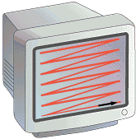
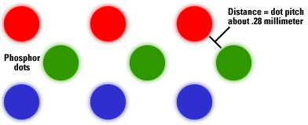
Size is measured
diagonally.
The picture is scanned
from left to right and
from top to bottom.
One complete set of scan
lines is called a frame.
Refresh rate = number of
frames in one second
Resolution = no. of pixels
(i.e. 1024 x 768)
1 pixel in a color monitor

Slide 31
Video Graphics Adapter
Common PC resolutions
640 x 480
800 x 600
1024 x 768
1600 x 1200
Output, Chapter 5

Slide 32
Output Devices
Engaging Our Senses
Video Adapters
  video RAM (VRAM)
  video graphics adapter (VGA)
  super VGA
  refresh rate
  flicker
Output, Chapter 5

Slide 33
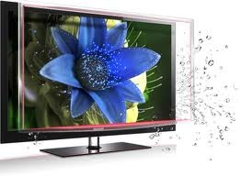
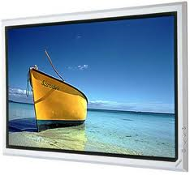

LCD , LED
AND
PLASMA TV

Slide 34

INTRODUCTION
Television (TV) is a telecommunication medium for transmitting and receiving moving images that can be monochrome (Black and White) or colored, with or without accompanying sound.
The word Tele is a Greek word meaning “Distant” and Vision meaning “Sight”.
The components used in old TV's are essentially very similar to the components used in modern TV's; that is, they perform the same function as their modern counterparts. Where they differ greatly however, is in their size.

Slide 35
There are different types of TV depending upon the display device used.
Display Device
A display device is an output device for presentation of information in visual form. When the input information is supplied as an electrical signal, the display is called an electronic display.
Types of Display Devices
Cathode Ray Tube
Flat - Panel Display

Slide 36
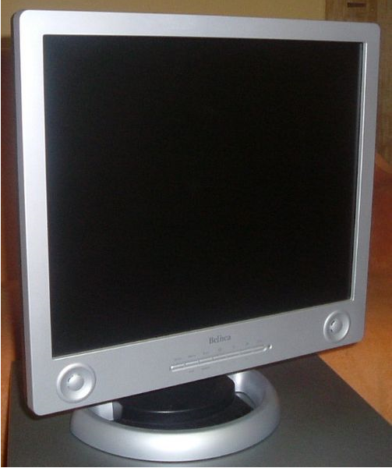
FLAT PANEL DISPLAY
Flat panel displays (sometimes referred to as flatscreens, which more technically mean screens with fully flat front surfaces) encompass a growing number of electronic visual display technologies.
They are far lighter and thinner than traditional television sets and video displays that use cathode ray tubes (CRTs), and are usually less than 10 centimetres (3.9 in) thick.

Slide 37
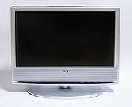
LIQUID CRYSTAL DISPLAY(LCD)
Liquid-crystal display televisions (LCD TV) are color television sets that use LCD technology to produce images
Produces colored image by selecting filtering a white light
Thinner and lighter than CRTs of similar display size
The concept of LCD was 1st brought up by Philips

Slide 38

LED-TVS
An LED-backlit LCD display is a flat panel display that uses LED backlighting instead of the cold cathode (CCFL) backlighting used in other LCD displays.
While not an LED display, televisions using this display are called "LED TV" by some manufacturers and suppliers.
The use of LED backlighting allows for a thinner panel, lower power consumption, better heat dissipation, a brighter display, and better contrast levels
Three forms of LED may be used:
White edge-LEDs around the rim of the screen, using a special diffusion panel to spread the light evenly behind the screen (the most usual form)
A full array of LEDs arranged behind the screen whose brightness are not controlled individually

Slide 39
DIFFERENCE BETWEEN LCD AND LED
Produce images with greater dynamic contrast;
With edge-LED lighting can be extremely slim, some screens less than half an inch (0.92 cm) thick.
Offer a wider color gamut when RGB-LED backlighting is used.
Produce less environmental pollution on disposal;
Are more expensive;
Have typically 20 to 30% lower power consumption;
Are more reliable.
Can allow a wider dimming range.

Slide 40
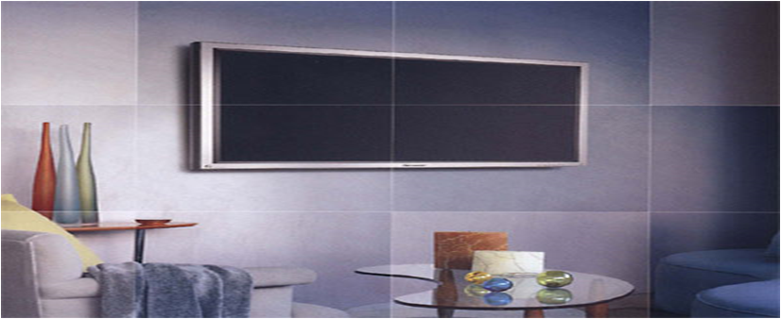
PLASMA TV
Plasma display screens are made from glass, which reflects more light than the material used to make an LCD screen.
A plasma display panel (PDP) is a type of flat panel display common to large TV displays 30 inches (76 cm) or larger.
They are called "plasma" displays because the technology utilizes small cells containing electrically charged ionized gases
Capable of producing deeper blacks allowing for superior contrast ratio

Slide 41
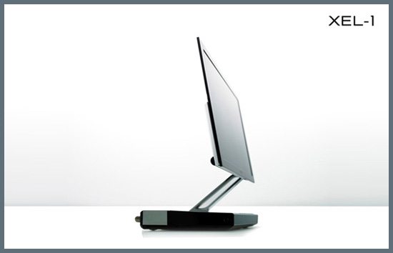
FUTURE TECHNOLOGY OF TV
OLED (Organic light emitting diode)
Sony introduced this technology in 2008
It doesn’t required backlighting
Allow less power consumption
Screen are so thin and so flexible that one can roll them up like a carpet
We will have OLED based TV in our living room around 2015

Slide 42
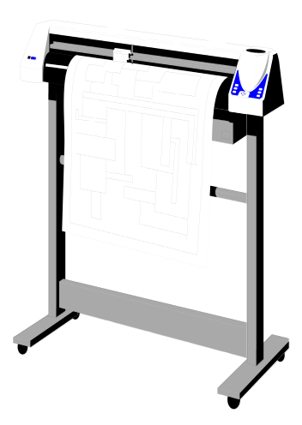
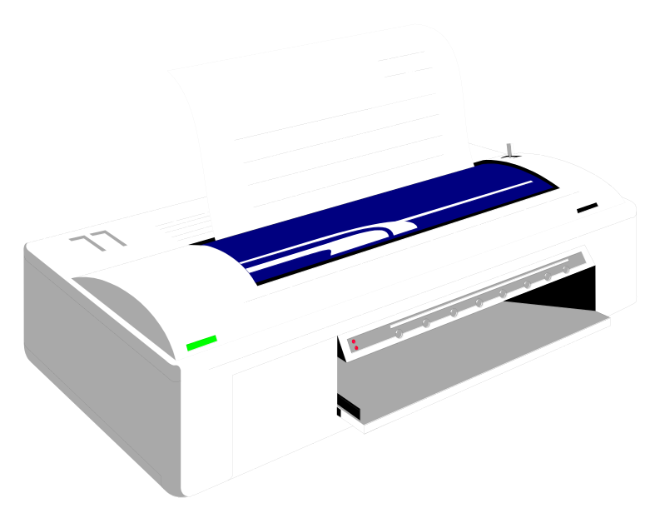
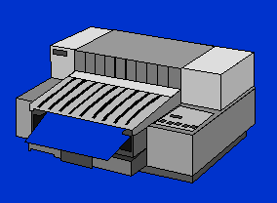
Output Devices
Impact
  Line printers
  Character printers
  Dot-matrix printers
Non-impact
  Laser printers
  ➢Inkjet printers
  ➢ Thermal
  Plotters
Output, Chapter 5

Slide 43
Printers
An output device that produces text and graphics on a physical medium such as paper or transparency film
Hard copy (printout)
Portrait vs. landscape
Printing requirements vary
Output, Chapter 5

Slide 44
Printers
Impact Printers
  Printing mechanism strikes paper, ribbon and character together
  Not usually letter quality (LQ)
  Many are near letter quality (NLQ)
  Used for multipart forms
Output, Chapter 5

Slide 45
Printers (Continued)
Impact Printers
  Dot matrix printers
    Small dots form characters
    Continuous form paper
    More pins on print head means higher quality
    Speed measured in characters per second (cps)
Output, Chapter 5

Slide 46
Impact Printers
There is some physical contact with the paper to produce the image ie physically striking the paper
Types
  Line printers
  Dot matrix printers

Slide 47
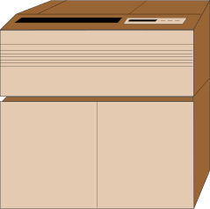
Line Printer
Line printers
  Used by mainframes for
  jobs that need a large volume of printing
  Limited characters available
  Print an entire line at a time
  Cheap to run
  Not high quality

Slide 48
Dot Matrix Printer
Have a printhead made up of columns of pins
  The pins form characters and images as patterns of dots produced when the pins strike the paper
  Reasonable quality text and graphics
  Inexpensive to buy and run
  Noisy

Slide 49
Non-Impact Printers
Laser Printers
Ink-jet printers
Bubble-jet printers

Slide 50
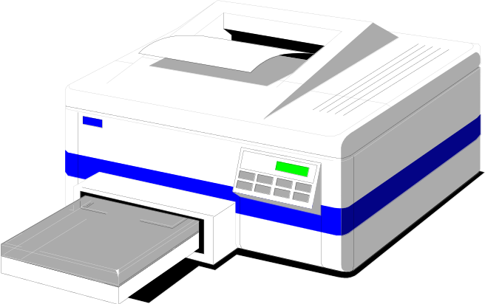
Laser Printers
Laser printers
  Image transferred to paper with a laser beam
    Faster and more expensive
    than dot-matrix
    High-resolution output
    Expensive to buy
    Quite expensive to run

Slide 51
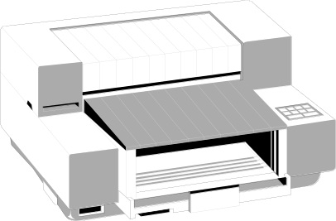
Ink-Jet Printers
Ink-jet
  Dots of ink are sprayed onto the paper to form the image
  Reasonably high quality
  Available in colour or B/W
  Speed measured in pages per minute
  Reasonably priced
  Expensive to run

Slide 52
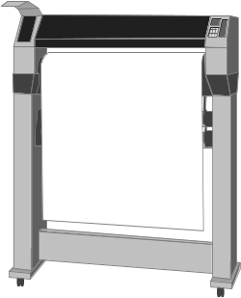
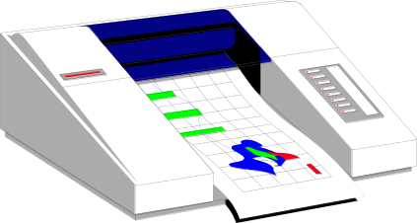
Plotters
Used by graphic designers/architects
  Image transferred to paper with ink pens
  Very high resolution
  Excellent for scientific and engineering applications

Slide 53
Printing Terms
Dots per inch (dpi)
Pages per minute (ppm)
Characters per second (cps)
Laser printers – 50 ppm
Ink-jet printers – 12 ppm

Slide 54
Printers (Continued)
Impact Printers
  Line printers
    High speed
    Prints an entire line at a time
    Band printer
    Shuttle-matrix printer
Output, Chapter 5

Slide 55
Printers (Continued)
Nonimpact Printers
  No mechanism strikes the paper
  Much quieter than impact printers
Output, Chapter 5

Slide 56
Printers (Continued)
Nonimpact Printers
  Ink-jet printers
    Spray tiny drops of ink onto the paper
    Both black-and-white and color
    Resolution measured in dots per inch (dpi)
    Speed measured in pages per minute (ppm)
    Nozzles spray ink
Output, Chapter 5

Slide 57
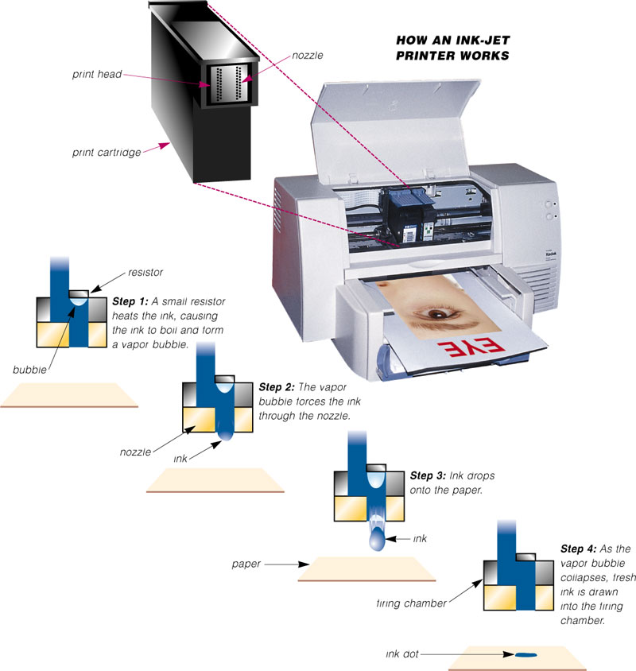
Output, Chapter 5

Slide 58
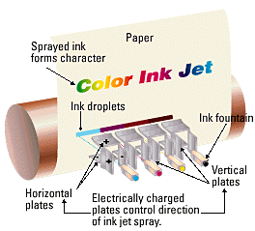
Ink jets are popular because of their
relatively low cost and color capability.
Output, Chapter 5

Slide 59
Printers (Continued)
Nonimpact Printers
  Laser printers
    High-speed, high-quality nonimpact printer
    Very high quality resolution - 600dpi to 1,200 dpi
    Stores entire page before printing it
    Page description language (PDL)
      PCL (Printer Control Language)
      Postscript
Output, Chapter 5

Slide 60
Printers (Continued)
Nonimpact Printers
  Laser printers
    Operates much like a copy machine
    Toner
    Replace cartridge
Output, Chapter 5

Slide 61
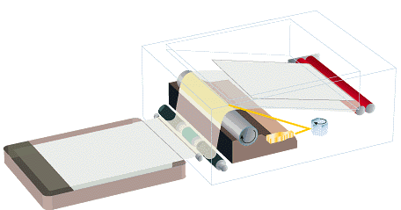
Laser printers are faster and
capable of high resolution.
Heat roller bonds
toner to paper
Toner transferred
from drum to paper
Rotating
mirror
Laser beam
Laser transfers
image to drum
Paper is given a
static charge
Output, Chapter 5

Slide 62
Printers (Continued)
Nonimpact Printers
  Thermal printers
    Pushes electrically heated pins against heat-sensitive paper
    Thermal wax-transfer printer
    Dye-sublimation printer
Output, Chapter 5

Slide 63
Printers (Continued)
Nonimpact Printers
  Portable printers
    Small, lightweight printer that allows a mobile user to print from a laptop or handheld computer while traveling
    Ink-jet
    Thermal or thermal wax-transfer
    Parallel port or infrared port
Output, Chapter 5

Slide 64
Printers (Continued)
Nonimpact Printers
  Plotters and Large-Format Printers
    Used for high-quality drawings such as blueprints, maps, circuit diagrams, and signs
    Plotters
      Pen plotters
      Electrostatic plotters
    Large-format printer
      Photo-realistic quality color prints
Output, Chapter 5

Slide 65
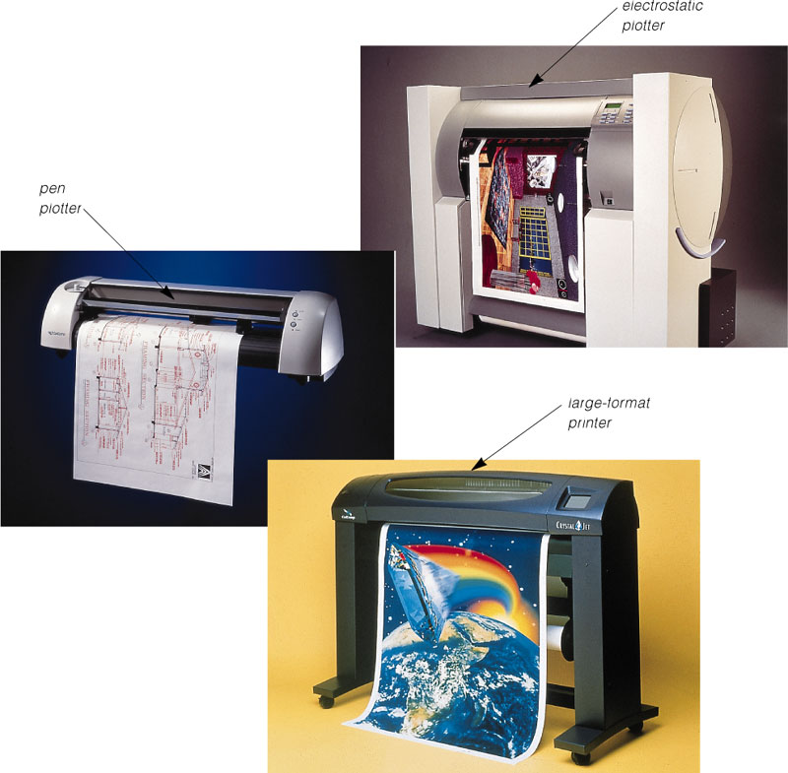
Plotters
Output, Chapter 5

Slide 66
Printers (Continued)
Nonimpact Printers
  Special-purpose printers
    Photo printer
      Photo lab quality pictures
    Label printer
Output, Chapter 5

Slide 67
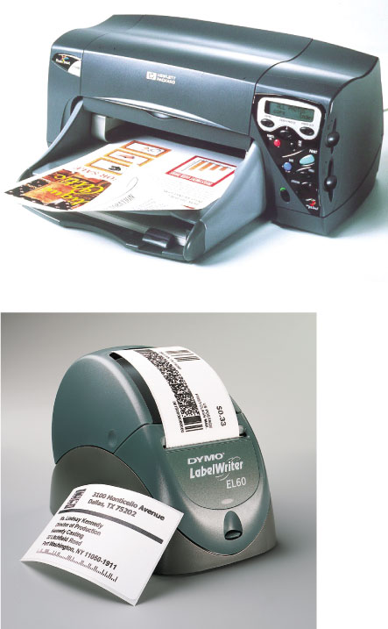
Output, Chapter 5

Slide 68
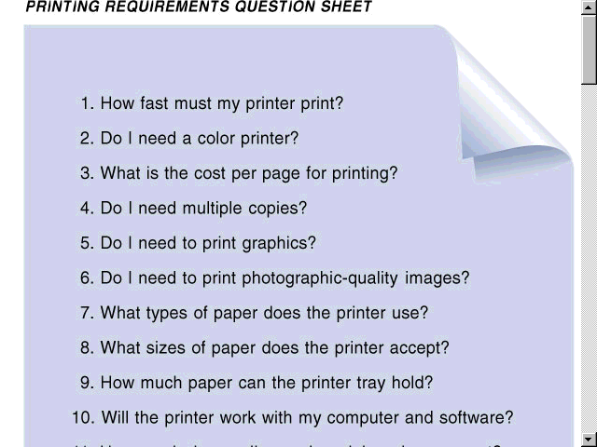
Printing Requirements Question Sheet
Output, Chapter 5

Slide 69
Input/Output Ports
Identification And Function

Slide 70
Device Connection
All devices that connect outside of the computer must use a port to connect
Known as I/O ports (Input/Output)
Bits can travel in parallel or in serial

Slide 71
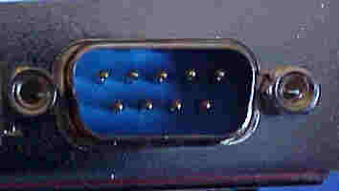
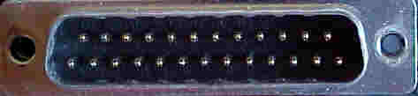
Serial Connectors
Can use a 9 or 25 pin male sub-D connector
Slowest ports
Used for:
  Mice
  Keyboards
  Modems

Slide 72
Serial Ports
Also called COM1, COM2, COM3, and COM4
Can be referred to as a RS-232 port
This is a standard that defines serial communication

Slide 73
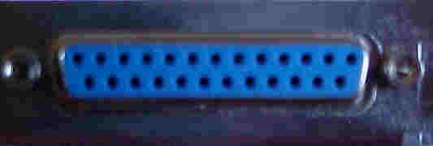
Parallel Ports
Uses a 25 pin female sub-D connector
Data flows over 8 lines
Used for:
  Printers
  Scanners
  Portable drives

Slide 74

Parallel Ports
When used to connect to a printer, it uses a 36 pin centronics connector at the other end

Slide 75
Parallel Ports
Also called LPT(Line Printer Terminal)1, LPT2, LPT3
Bi-directional communication
  Called Enhanced Printer Port (EPP)
Transmission mode can be set in the BIOS
Maximum cable length is 15 feet

Slide 76

PS/2 and Keyboard Connectors
PS/2 connectors are used for both mice and keyboard
Also called 6-pin mini DIN
Green for mouse
Purple for keyboard
Not interchangeable
Standard for ATX boards

Slide 77

DIN-5 Keyboard Connector
Older motherboards use a DIN-5 connector for the keyboard and a 9 pin serial connection for the mouse

Slide 78
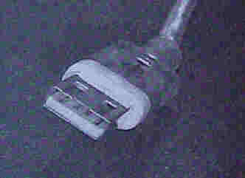
Universal Serial Bus (USB)
Used to connect almost all peripherals
Can connect up to 127 devices
Designed to be hot-swappable
Designed to connect in a daisy chain

Slide 79
USB Standards
USB 1.1 – 12 Mbps
USB 2.0 – 480 Mbps
A-Style connector is used on the computer or hub
B-Style connector is used on the device
Must have Windows 98, 2000 or XP
Not supported in Windows 95 or NT 4.0

Slide 80
USB Cable Lengths
Hi Powered devices – 5 meters max
  Also called hi-speed
Low Powered devices – 3 meters max
  Also called low-speed
Can be extended if you use a self-powered hub

Slide 81
FireWire
Also called IEEE-1394
Used for digital cameras, camcorders, and scanners
Bi-directional communication
Developed by Apple Computers
Requires a special adapter card

Slide 82
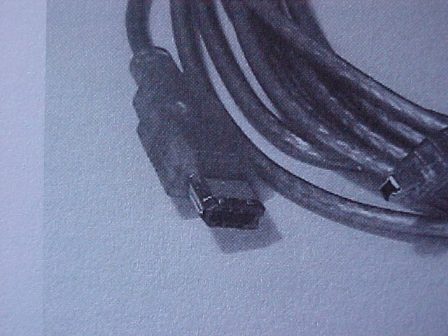
FireWire Cable Length
4.5 meters max length
Hot-swappable
Transfer rate of 400 Mbps
Supports 63 devices in a daisy chain

